Slide 1



Revolutionizing Road Safety
Presented by: Tanmay Singh, 2130155
Anikait Barik, 2130166
Himanshi Deep, 2130182 Manu Siddharth Verma, 2130202
Under the supervision of, Prof. Subhrakanta Behera

Slide 2


Introduction & Background
Problem Importance:
Drowsiness is a significant factor in road accidents and workplace incidents, particularly in transportation and hazardous in dustries.
Road Safety: Drowsy driving accounts for around 10 -20% of car accidents globally, according to traffic safety studies.
Workplace Monitoring: Industries with heavy machinery or long shifts see high accident rates due to worker fatigue.
Objective of the Project:
Develop a real-time drowsiness detection system that identifies signs of drowsiness and sends timely alerts to prevent potential accidents.
Literature Review
Existing Solutions:
Camera-Based Monitoring: Uses facial landmark detection to monitor signs of fatigue, such as eye closure and head tilts.
Wearable Devices: Includes headbands or glasses that monitor brain waves or eye movement, detecting drowsiness through physiological changes.
Vehicle-Based Sensors: Analyzes vehicle behavior like steering angle and lane deviation, often used in advanced driver assistance systems.
Comparative Insights:
Camera-Based: High accuracy in detecting facial cues but relies on clear, stable camera feed.
Wearable Devices: Provides precise data but may be uncomfortable or invasive for users.
Vehicle-Based Sensors: Non-intrusive but limited to vehicle movement patterns and might not work in all environments.
This brief, targeted overview should set up the foundation for your project and highlight the need for innovation in drowsine ss detection.

Slide 3
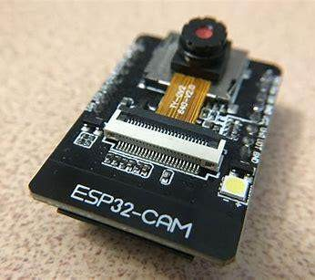
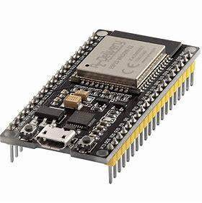

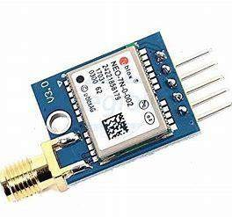
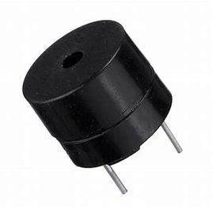
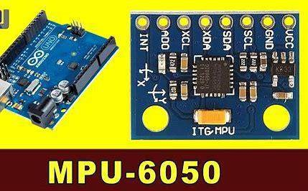
Components
Hardware
ESP32-CAM: Captures live video and streams it via Wi- Fi.
ESP32: Central unit for alerts and communication.
MPU6050: Detects sudden movements/accidents.
GPS Module: Provides real-time location data.
Buzzer: Emits alerts for drowsiness/accidents.
ESP 32 CAM
ESP 32
Software
Python IDE: Runs drowsiness detection code.
OpenCV: Analyzes video for facial cues.
Communication Protocols: HTTP, WebSocket, or MQTT for data exchange.
Alert Manaoftement: Triggers and manages alerts efficiently.
Neo 7n GPS
Buzzer

Slide 4
Methodology
System Overview
ESP32-CAM: Captures real-time video feed and streams it to a local computer.
Local Computer (Python Server): Processes video feed to detect drowsiness.
Drowsiness Detection Process
Face and Eye Detection: Analyzes facial landmarks for signs of drowsiness (e.g., eye aspect ratio).
Decision Trigger: If signs are detected, sends an alert to the ESP32.
Communication Protocol
Data Transfer: ESP32-CAM streams to the Python server.
Alert Communication: Python server sends alert back to ESP32 via HTTP/WebSocket/MQTT.
Alert Mechanism
ESP32 Response: Activates buzzer or sends notifications upon receiving alert.

Slide 5
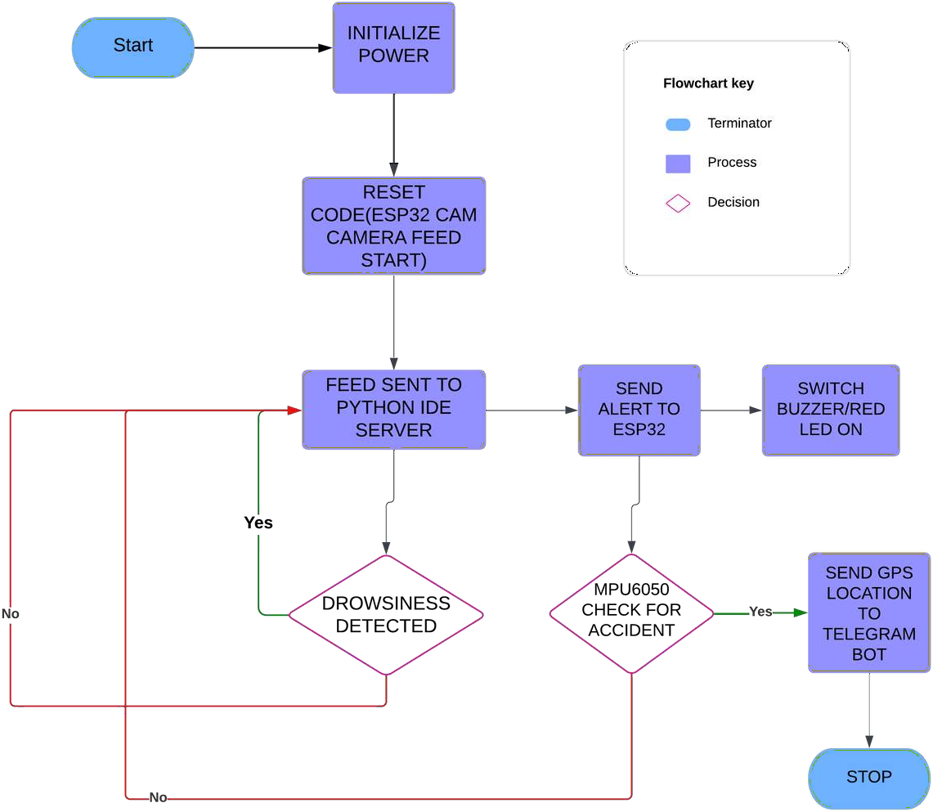
Flow Chart

Slide 6
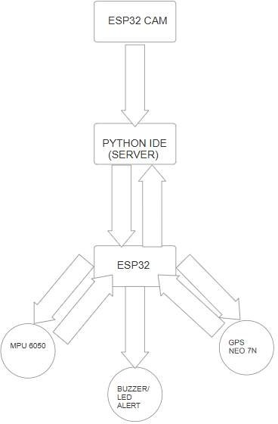
Block Diagram

Slide 7

Drowsiness Detection Aloftorithm
Input: Video feed from ESP32-CAM
Output: Drowsiness alert
Capture video frames.
For each frame:
Convert to grayscale.
Detect face landmarks.
Calculate Eye Aspect Ratio (EAR).
If EAR is below the threshold for too lonoft:
Trigger drowsiness alert to ESP32.
Accident Detection Aloftorithm (Usinoft MPU6050)
Input: Data from MPU6050 Output: Accident alert Read data from MPU6050.
Check for sudden changes in acceleration.
If acceleration exceeds the threshold:
Trigger accident alert and send GPS location.
GPS Location Sendinoft Aloftorithm
Input: GPS data
Output: Location data to server
Get GPS coordinates continuously.
If drowsiness or accident alert occurs:
Send current GPS location to the server.
Algorithms

Slide 8

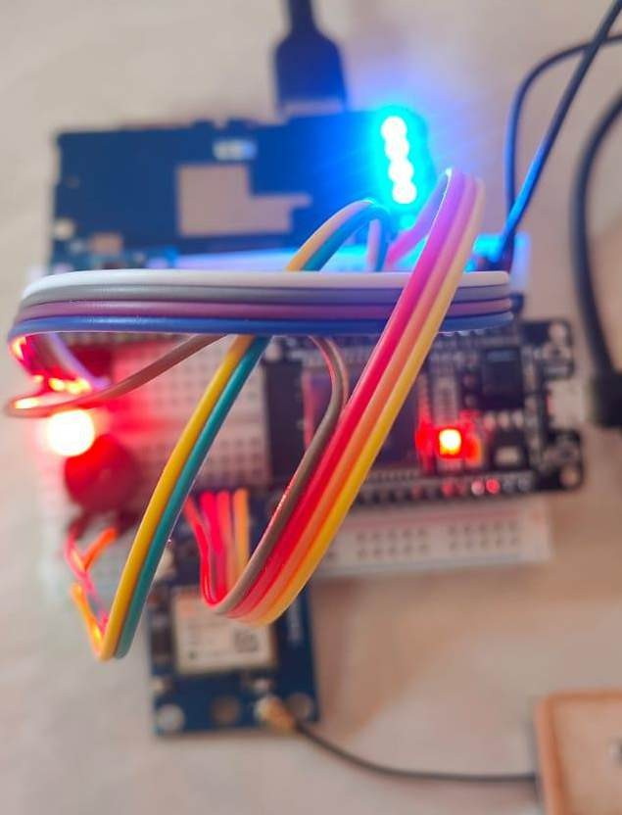
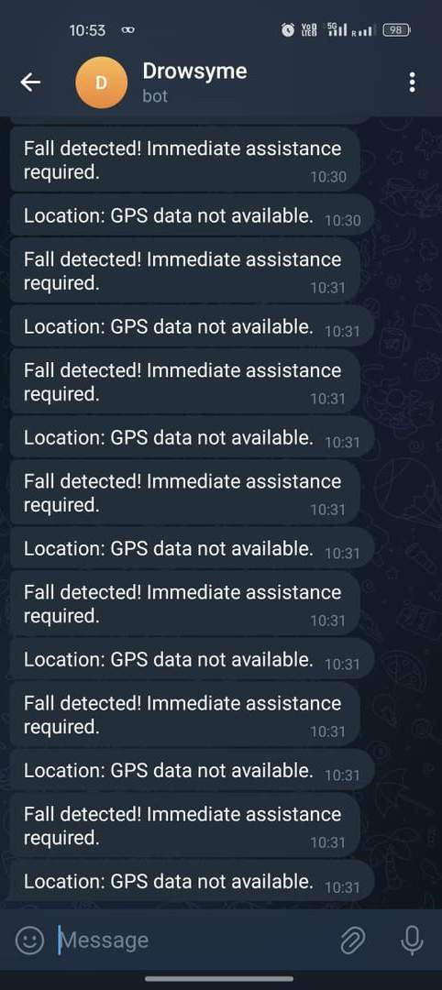
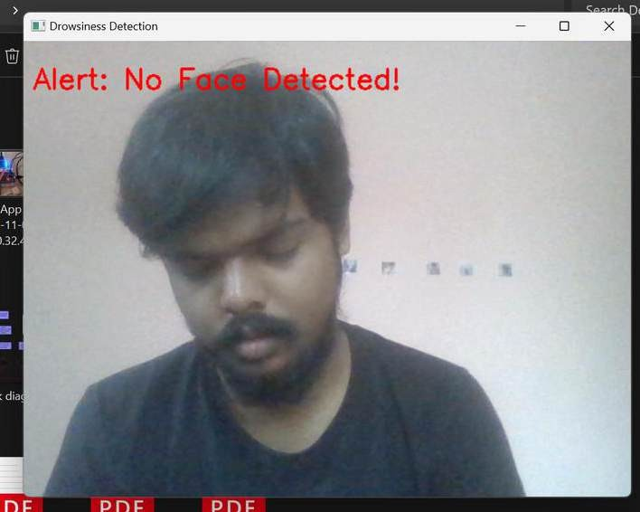
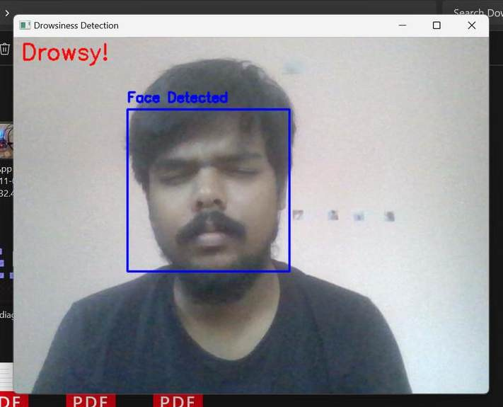
System Testing & Results

Slide 9

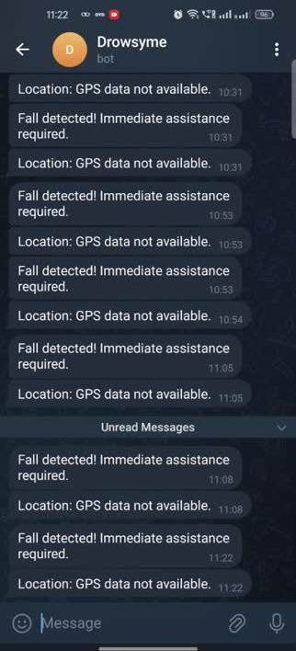

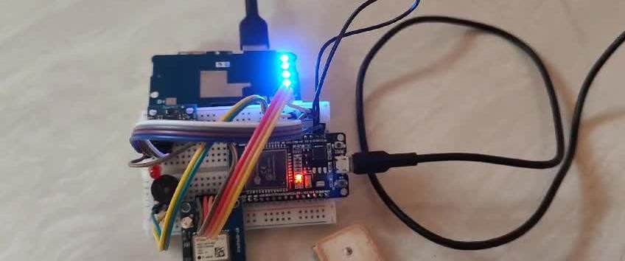
System Testing & Results

Slide 10




Chalenges & Solutions
Video Streaming Noise
Feed Reception Issues
Challenge: Interference and noise in the video feed caused inaccuracies in drowsiness detection.
Solution: Implemented filtering techniques and optimized the
camera settings to enhance image
clarity.
Challenge: Occasional drops in video feed reception affected real- time analysis.
Solution: Improved network stability by using wired connections where possible and optimizing the ESP32-CAM's streaming settings.
Compatibility Problems
Simultaneous Alert Handling
Challenge: Integration issues between different hardware components (ESP32, sensors, GPS) and the Python server.
Solution: Standardized communication protocols (e.g.,
MQTT) and ensured firmware compatibility across devices.
Challenge: Difficulty managing multiple alert types (drowsiness, accidents) simultaneously without system overload.
Solution: Prioritized alert signals and implemented a queuing system
to manage and process alerts
sequentially.

Slide 11






Model Refinement:
Improve drowsiness detection accuracy by incorporating advanced machine learning models or training on larger datasets.
Location-Based Alerts: Use GPS to send automated location updates to emergency contacts or nearby assistance centers.
Mind map
Future Enhancement
Enhanced Alerts: Implement vibration or audio alerts customized for different alert levels (e.g., escalating alert for prolonged drowsiness).
Cloud Integration:
Store alerts and location data in
the cloud for real-time tracking, logging and analysis.
Vehicle-to-Vehicle (V2V) Communication:
Implement V2V to share drowsiness alerts and accident warnings with nearby vehicles, improving overall road safety.
Mobile App Integration: Develop a companion mobile app to receive real-time alerts and location data, enabling quick access for emergency contacts or fleet managers.

Slide 12



Conclusion
With rapid advancements in technology, vehicle safety has become increasingly important. Our project offers an automated, low-cost, and energy-efficient system designed to reduce accidents caused by drunk driving, drowsiness, and engine overheating. The system integrates various sensors to monitor driver and vehicle conditions, providing warnings and corrective actions to prevent accidents.
If an accident occurs, the system uses GPS to determine the exact location and GSM to alert emergency services immediately. This quick response capability enhances safety and can save lives. Affordable and easy to install, this system is a practical solution for improving vehicle safety across various types of vehicles.

Slide 13
Thank you very much!

